Slide 1
PEER-TO-PEER DECENTRALIZED BLOCKCHAIN TECHNOLOGY
Presentees :
Mr. V. Uday Bhaskar (18n81a0560)
Mr. Rajpara Tirth (18n81a0559)
Mr. Tingrikar Vinith (18n81a0557)
Mr. Mohan Prasad (18n81a0545)
Under the supervision of :
Mr. P. Ram Mohan Rao
Associate Professor & Head of the Department

Slide 2
contents
Abstract
Existing System and Proposed System
System Requirements
Modules
System Architecture
UML Diagrams
Conclusion

Slide 3
ABSTRACT
Created -> Purely Peer to Peer Network Version of Electronic Cash
Eliminated a third party finincal institution.
Propose a solution -> Double-Spending Problem using a peer-to-peer network.
The network timestamps transactions by hashing them into an ongoing chain of Hash-based Proof-of-work

Slide 4
1. Technial Issuses
2. Account Hacked
3. Transfer Limits
4. High Transfer Charges
5. Double Spending
Exisiting System
These all issuses are addressed in our Proposed System

Slide 5
SYSTEM REQUIREMENTS
SOFTWARE REQUIREMENTS
Operating System : Windows XP
Programming Language : Python, Django
IDE : PyCharm
Front End : HTML, CSS
HARDWARE REQUIREMENTS
RAM : 4GB and Higher
Processor : AMD Dual core processor
Hard Disk : 500GB Minimum

Slide 6
MODULES
Peer Module:
Used to create peers for the users involved in transaction.
Block Module:
The created peers stored in blocks.
Transaction Module:
The users make transactions after validation of blocks.
Chain Module:
Then the valid blocks are added to the chain making transaction completes.

Slide 7
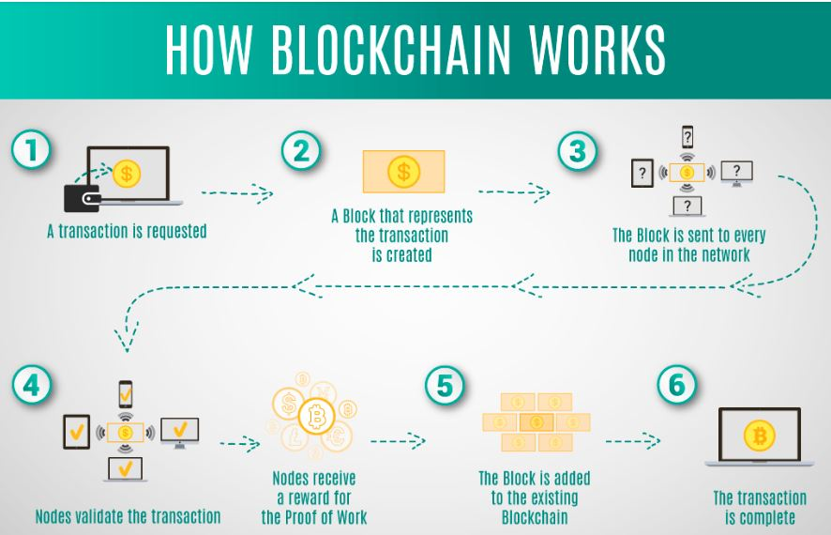
SYSTEM ARCHITECTURE

Slide 8
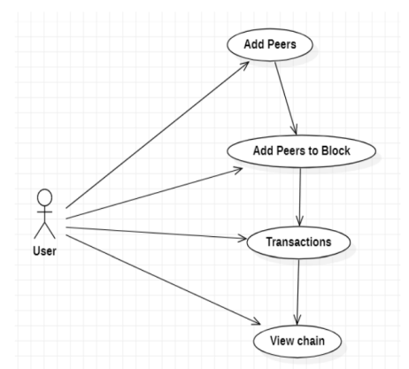
Use Case Diagram

Slide 9
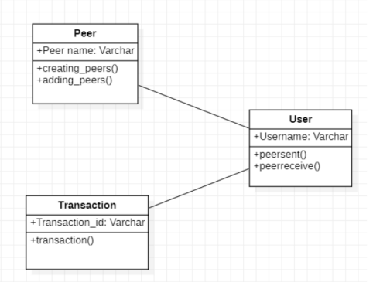
Class Diagram

Slide 10
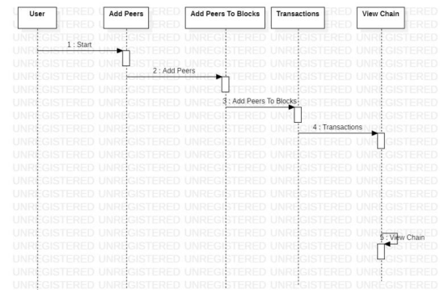
Sequence Diagram

Slide 11
CONCLUSION
We have proposed a system for electronic transactions without relying on trust.
The network is robust in its unstructured simplicity.
Issuses Solved : -
1. Technial Issuses
2. Account Hacked
3. Transfer Limits
4. High Transfer Charges
5. Double Spending

Slide 12
THANK YOU

